Slide 1
TypeScript JavaScript + NXT
@basarat
Google it

Slide 2
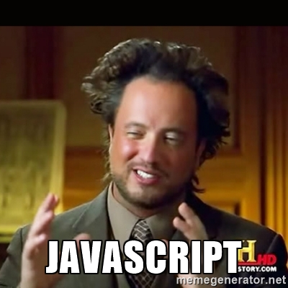

Slide 3
LESS WAT

Slide 4

WAT

Slide 5

AWWW

Slide 6

WAT

Slide 7
JavaScript
[].asdf()
TypeError:
[].asdf is not a function

Slide 8
JavaScript
[] + []

Slide 9
JavaScript
[] + []
""

Slide 10
JavaScript
[] + {}

Slide 11
JavaScript
[] + {}
"[object Object]"

Slide 12
JavaScript
{} + []
!= [] + {}

Slide 13
JavaScript
{} + []
0

Slide 14
JavaScript
{} + {}

Slide 15
JavaScript
{} + {}
V8
"[object Object][object Object]"

Slide 16
JavaScript
{} + {}
IE
NaN

Slide 17
JavaScript
"hello " + 1
hello 1

Slide 18
JavaScript
"hello " + (-1)
hello -1

Slide 19


Slide 20
JavaScript
"hello " - 1

Slide 21
JavaScript
"hello " - 1
NaN

Slide 22


Slide 23
We can lint this
"hello " - 1

Slide 24
Lint this?
function add(a,b){ return a+b }
add([], {})

Slide 25
Lint this?
function add(a,b){ return a+b }
add(foo, bar)

Slide 26
Lint this?
let foo = getServerFoo();
let bar = getServerBar();
someModule.add(foo,bar);

Slide 27

Linter on Steroids

Slide 28
JavaScript
let foo = [] + []
let bar = {} + []
let baz = [] + {}
let qux = {} + {}
let tix = "" - 123

Slide 29
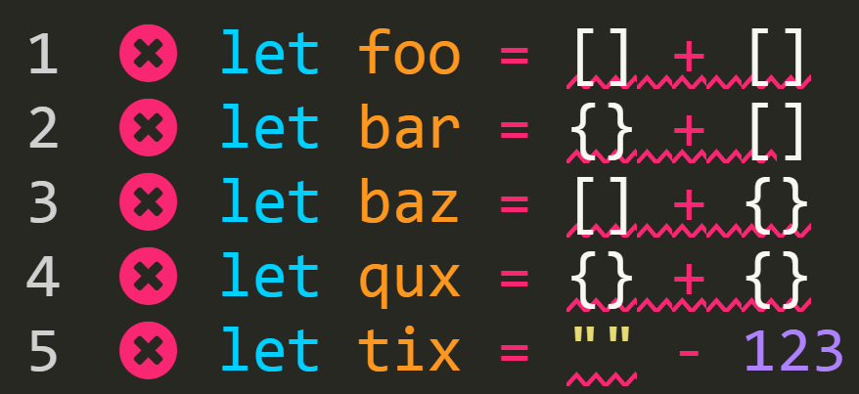
TypeScript

Slide 30

What is TypeScript?

Slide 31

Just JavaScript

Slide 32
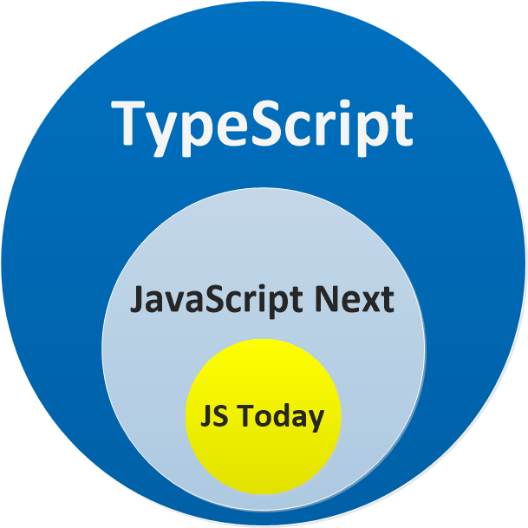

Slide 33
Linter
+
Transpiler

Slide 34
DEMO
JS File => TS File

Slide 35
Why Transpiler?

Slide 37
Quick Example
node.on('click', function() {
console.log('clicked!');
})

Slide 38
Quick Example
node.on('click', () => { console.log('clicked!');
})

Slide 39
Let / const
let funcs = [];
// create a bunch of functions
// Note the use of let
for (let i = 0; i < 3; i++) {
funcs.push(function() {
console.log(i);
})
}
funcs.forEach(f=>f())

Slide 40
But we won't need transpilation soon

Slide 41
The GAP
Todays JavaScript
Tomorrows JavaScript

Slide 42
Bridge
Todays JavaScript
Tomorrows JavaScript

Slide 43
MYTHS and Concerns

Slide 44
Static VS DYNAMIC

Slide 45
Test Claim
All I need are tests

Slide 46
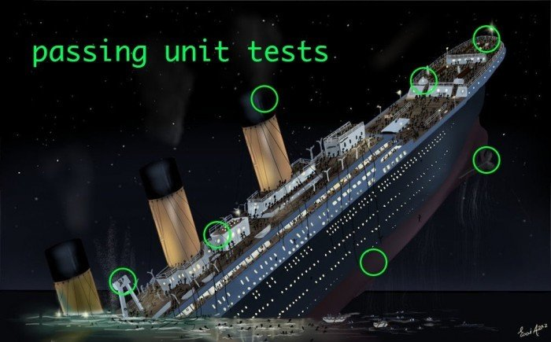
Tests
Notes:
Might be incomplete

Slide 47
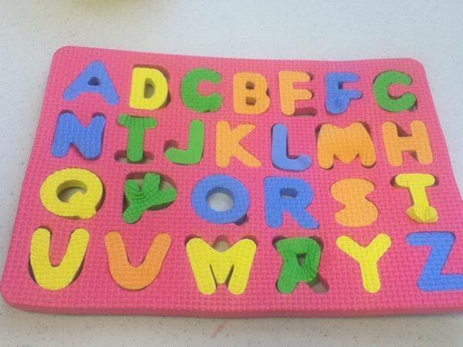
Just Tests
Notes:
Might be faulty

Slide 48

BUILDs
Notes:
Might be faulty

Slide 49
Types are docs
You can never provide good documentation without mentioning the types

Slide 50
Example
function leftPad (str, len, ch)

Slide 51
Just JavaScript
function add() {
return arguments[0] + arguments[1];
}

Slide 52
Just JavaScript
function add(num1, num2) {
return num1 + num2;
}

Slide 53
Optional
The TypeScript Type System is Optional

Slide 54
Just TypeScript
function add(num1, num2) {
return num1 + num2;
}

Slide 55
Just TypeScript
function add(num1: number, num2: number): number {
return num1 + num2;
}

Slide 56
Conventions
All I need are conventions

Slide 57
Conventions
People's name should be called `displayName`
People have a `userId`

Slide 58
Conventions
type Person = {
displayName: string,
userId: string,
}
function logName(person: Person) {
console.log(person.displayName)
}

Slide 59
Types are painful
I don’t need types as I did them in language x and it was painful

Slide 60
Conventional Languages
class ThrowItAll {
void show() throws Exception
{ throw new Exception("turtles"); }
void show2() throws Exception // Pain
{ show(); }
void show3() throws Exception // Pain
{ show2(); }
public static void main(String s[]) throws Exception
{ ThrowItAll o1 = new ThrowItAll(); o1.show3(); }
}

Slide 61
TypeScript is different
Ander’s calls it
“ gradually typed ”
I call it
“ types for developers, not compilers ”

Slide 62
Inference
let foo = 123;
// .... later
foo.toPrecision(3); // FINE

Slide 63
Inference
let foo = 123;
// ERROR: cannot assign str to number
foo = "Hello world";
// .... later
foo.toPrecision(3); // FINE

Slide 64
any
TS can move completely out of your way

Slide 65
any
let foo: any = 123;
foo = "Hello world";
// .... later
foo.toPrecision(3); // FINE

Slide 66
Structural
Names don’t drive compatibility.
Structures do

Slide 67

Structural

Slide 68
Structural
type Model = { name: string; }
type ViewModel = { name : string; }
let foo: Model = { name: "hello" };
let bar: ViewModel = { name: "world" };
foo = bar = foo; // FINE

Slide 69
Concern
Will it outlive my project lifetime?

Slide 70
Lifetime
Most likely outlive your project framework

Slide 71


Slide 72



Slide 73


Slide 74


Slide 75
Concern
But I don’t want to learn new syntax

Slide 76
New Syntax
CoffeeScript
DART
PureScript
way too many Foo -> JS languages

Slide 78
Additional Syntax
All about
* linting
* compiler useable (checkable) docs.

Slide 79
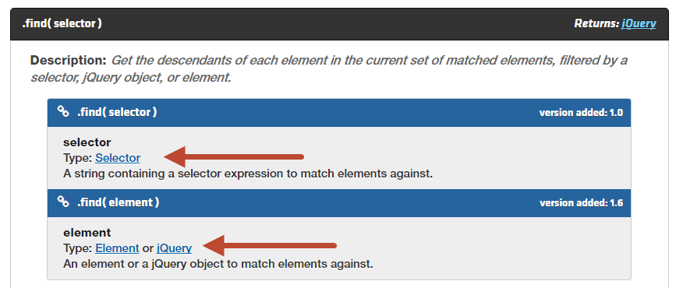

Slide 80
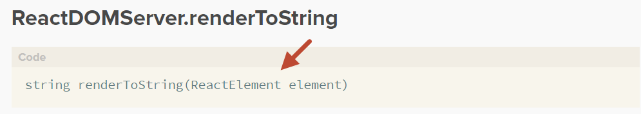

Slide 81
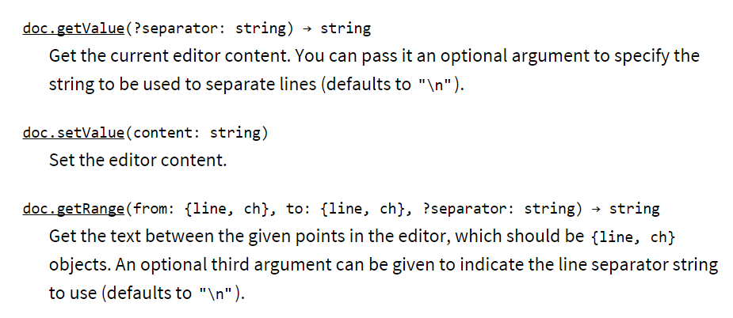

Slide 82
JS Libs ship Ts definitions
Moment.js
Redux IMMUTABLE

Slide 83
Concern
Its Microsoft

Slide 84


Slide 85
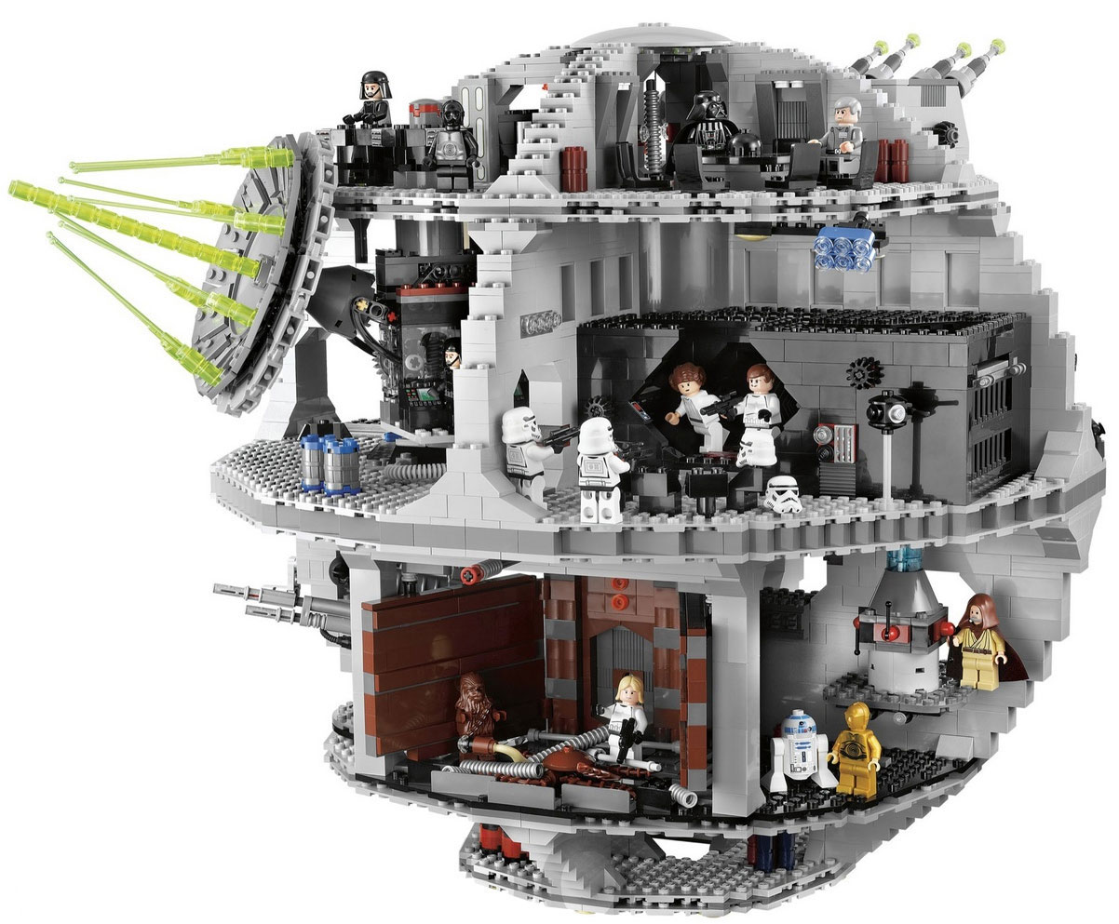

Slide 86


Slide 87
Enough talky Show me the code MOAR DEMOS

Slide 88
QUESTIONS

Slide 89


alm.tools
Google:
TypeScript Book

Slide 90
@basarat

